Slide 1
Scientific Python Introduction
Trygve Eftestøl

Slide 2
Aim of the course
Get to know Python
  What is Python?
    Why use Python?
  Basic training
    User interface
    Basic functions
    Visualisation
    Programming
    Analysis

Slide 3
What is Scientific Python?
Python
  object oriented programming language
Scientific
  Add numpy, matplotlib, scipy
Why use Python?
  Mathematcal computations
  Visualisation
  Analysis
  Used a lot for problem solving
    Cybernetics
    Signal processing
    Image processing
    Pattern recognition
    …

Slide 4
Basic training
User interface
Basic functions
Visualisation
Programming
Analysis

Slide 5
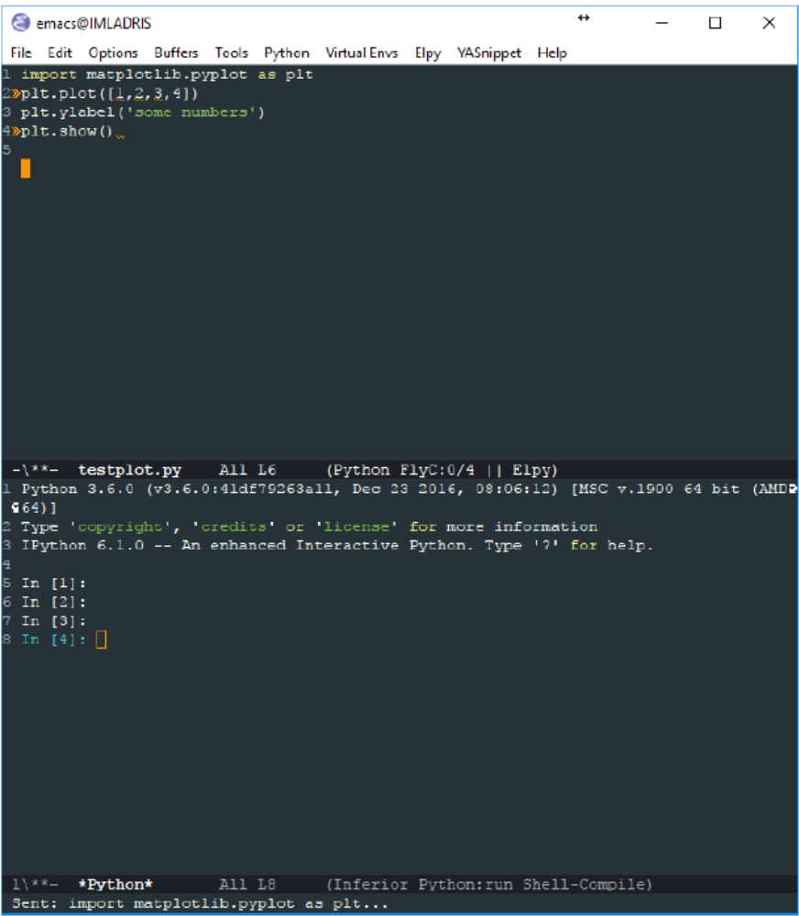
User interface
Interpreter window
Editor
Help

Slide 6
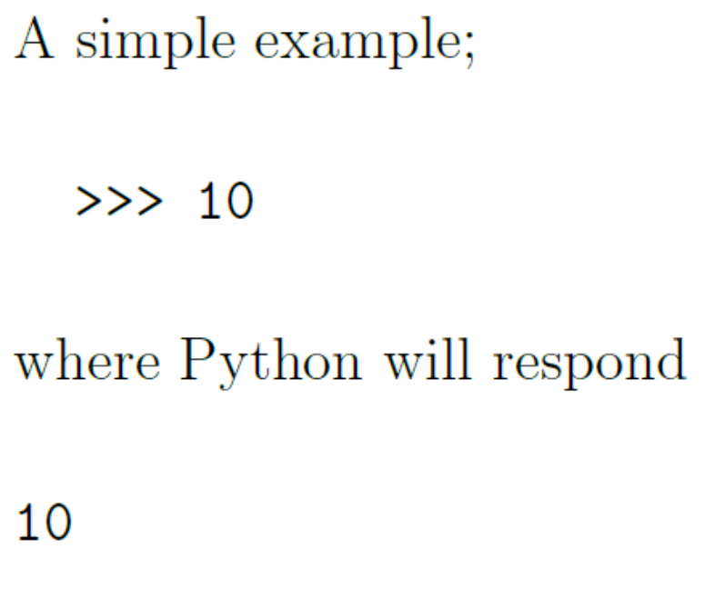
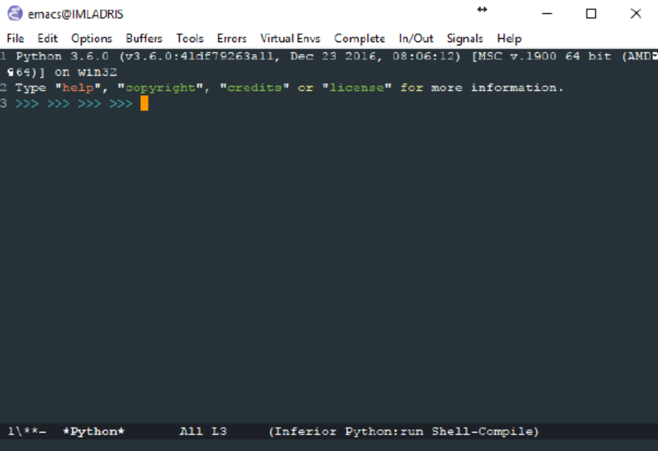
User interface
Interpreter

Slide 7
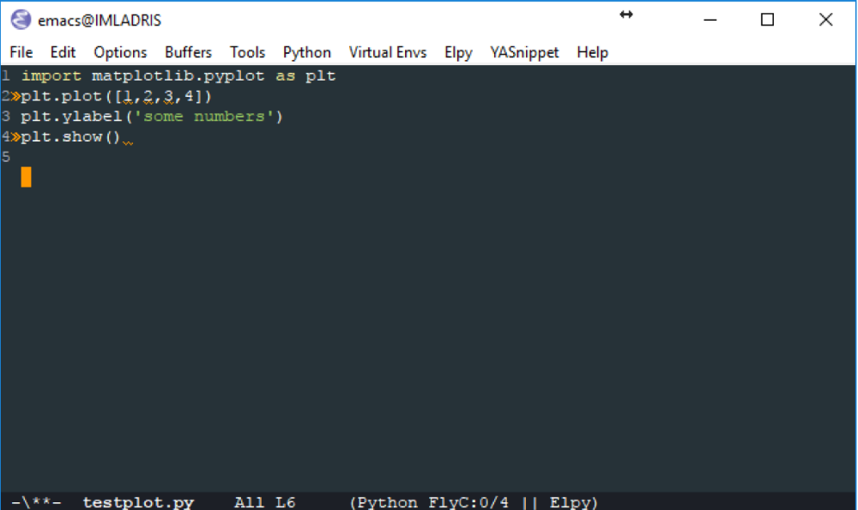
User interface
Editor

Slide 8
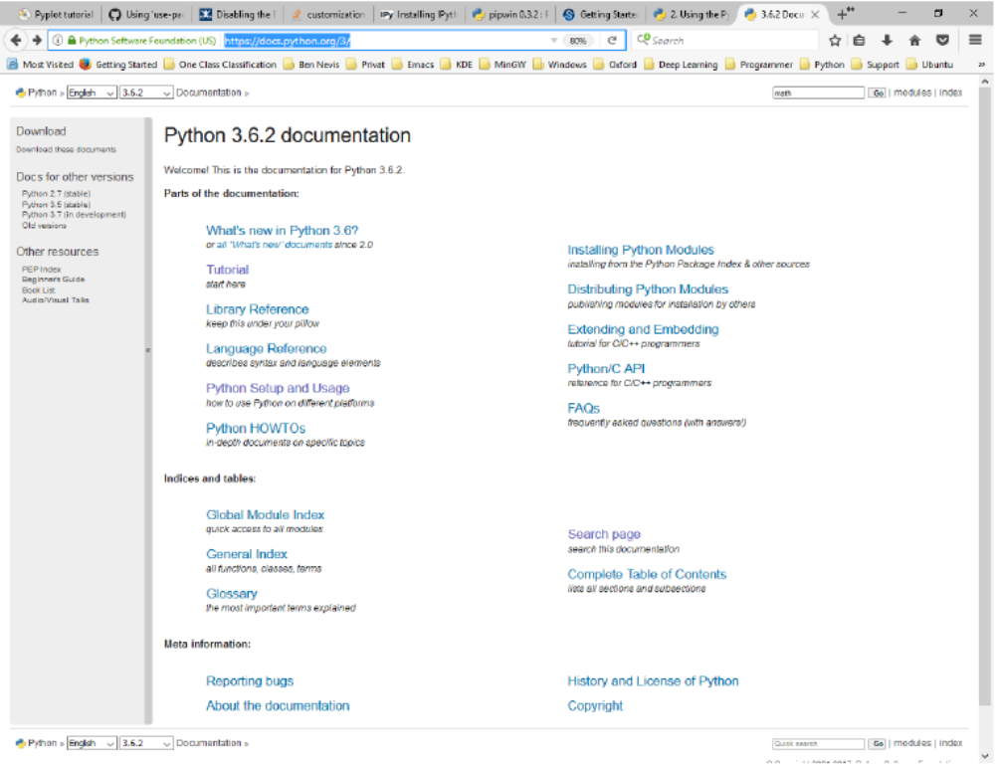
User interface
Help
  Documentation
  Search

Slide 9
Basic functions
Create matrices
Matrix operations
Matrix functions
Matrix indexing
Logical operations

Slide 10
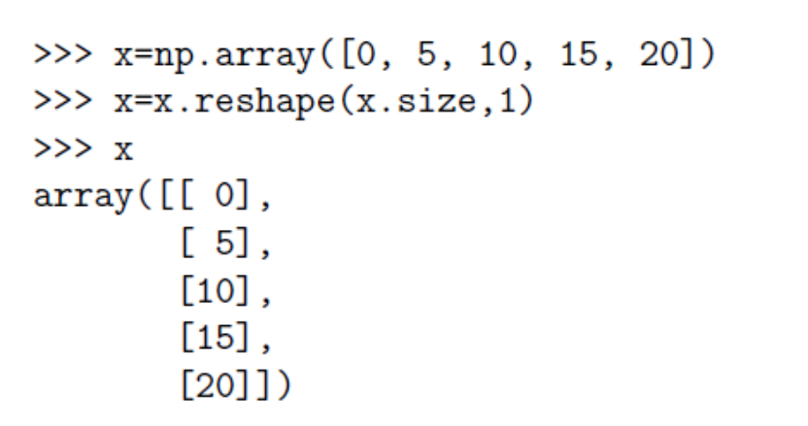
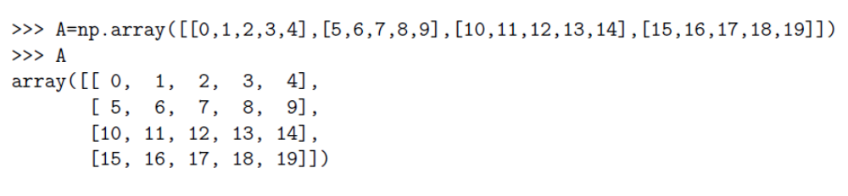
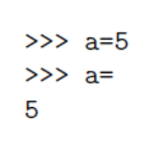
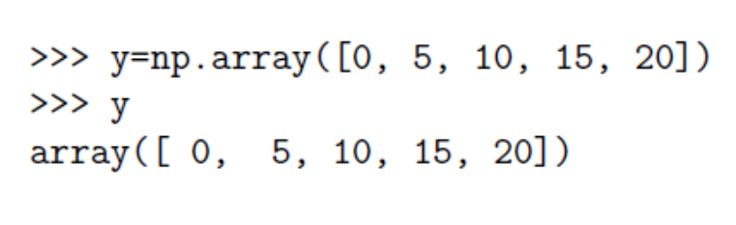
Basic functions
Create matrices
  Scalar
  Vector
  Matrix

Slide 11
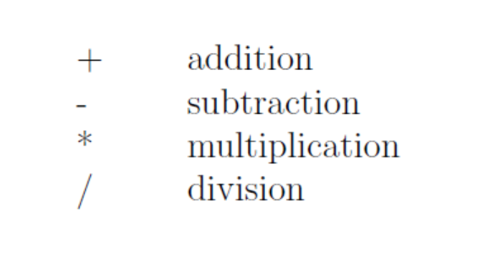
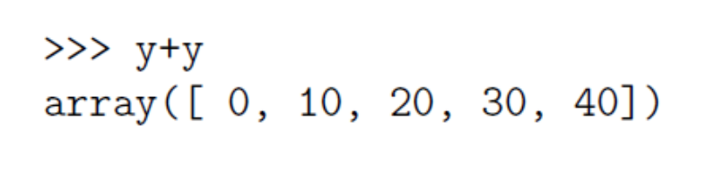
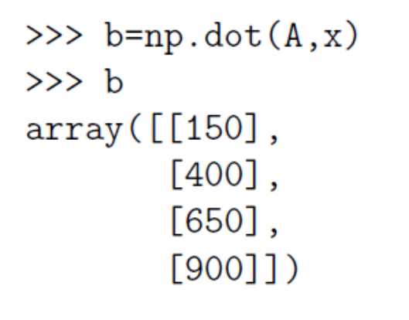
Basic functions
Matrix operators

Slide 12
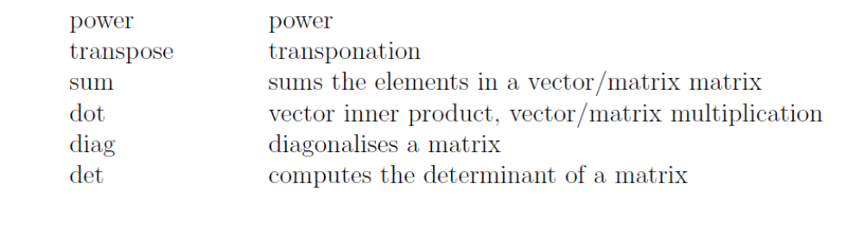
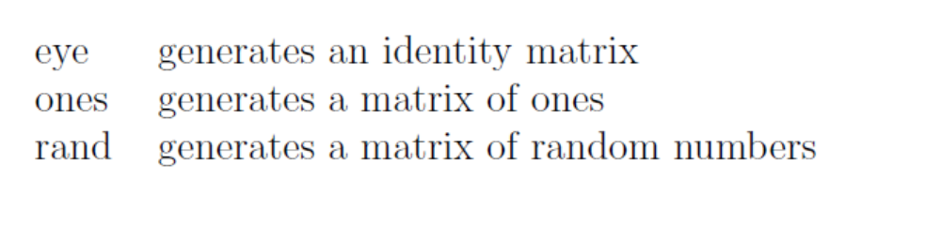
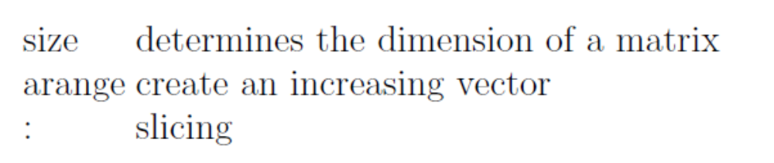
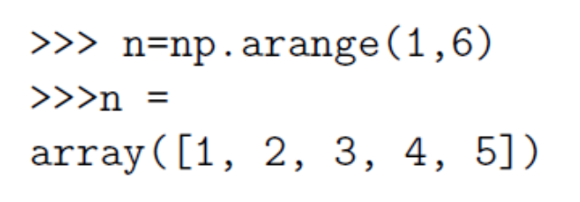
Basic functions
Matrix functions

Slide 13
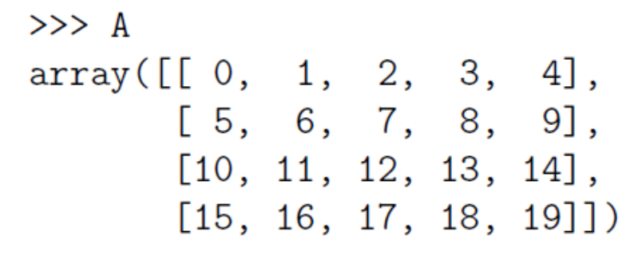
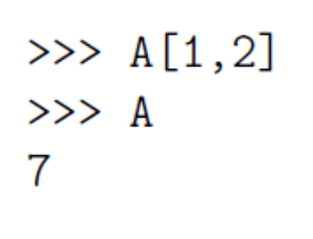
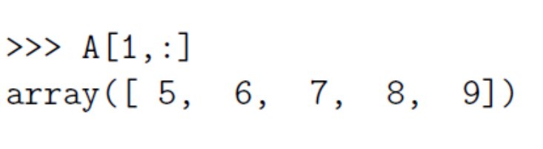
Basic functions
Matrix indexing

Slide 14
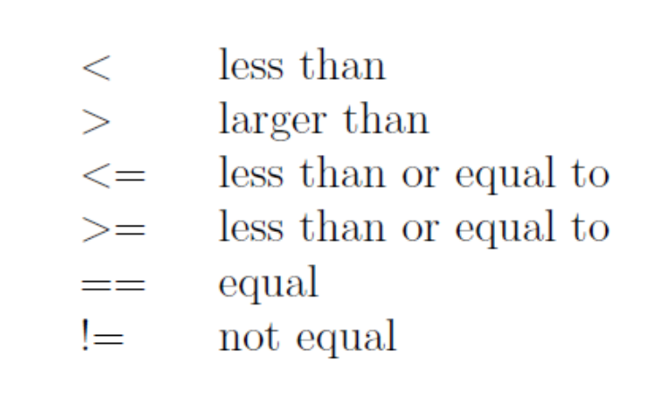
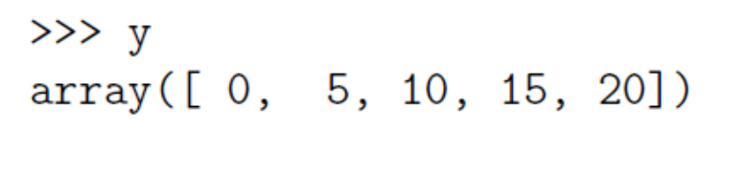
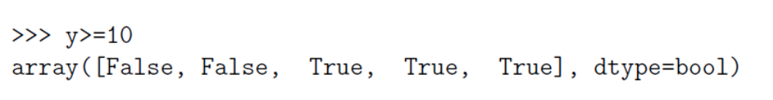
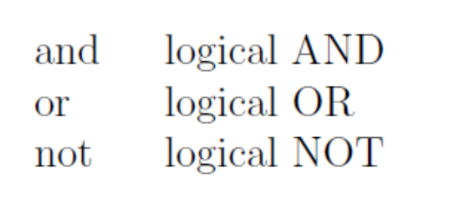
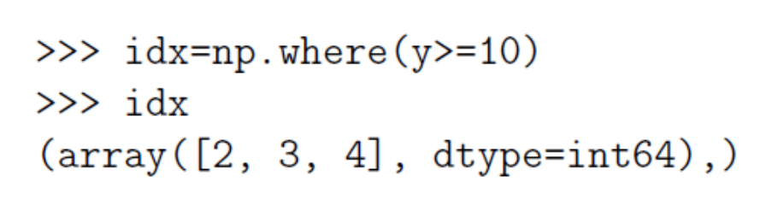
Basic functions
Logical operators

Slide 15
Visualisation
2D-plotting
3D-plotting

Slide 16
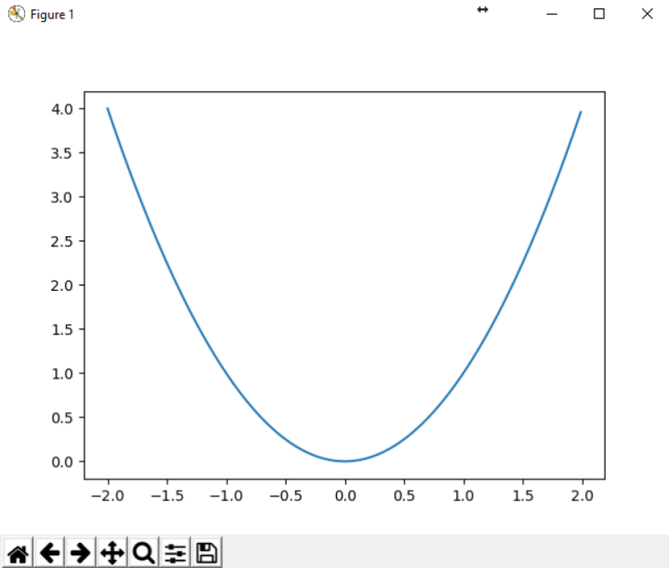


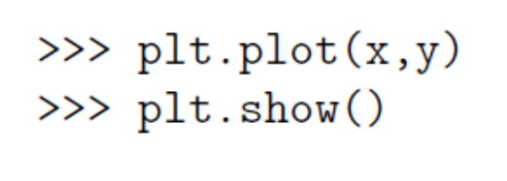
Visualisation
2D-plotting

Slide 17
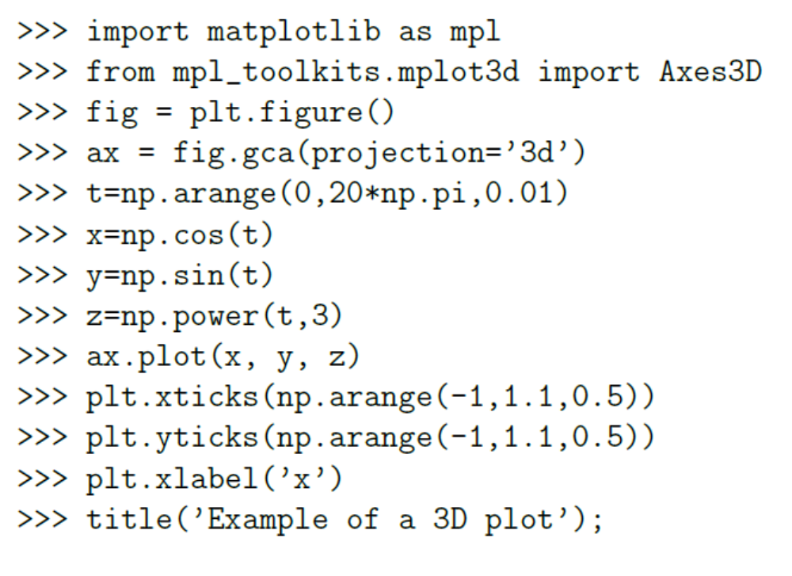
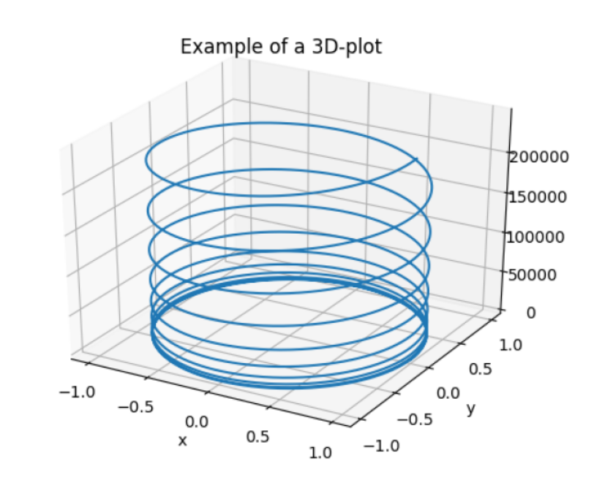
Visualisation
3D-plotting

Slide 18
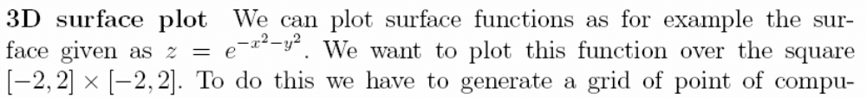
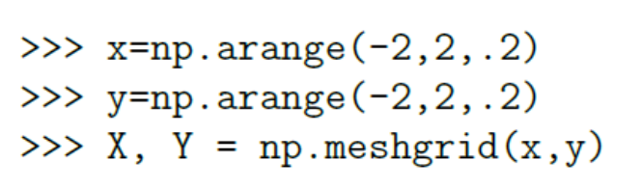
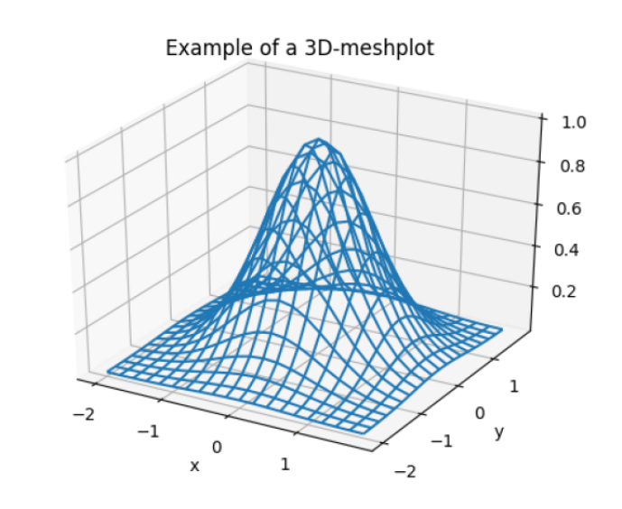
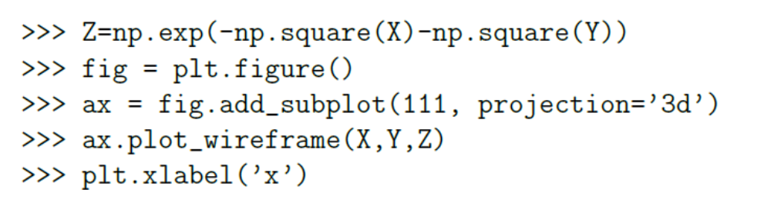
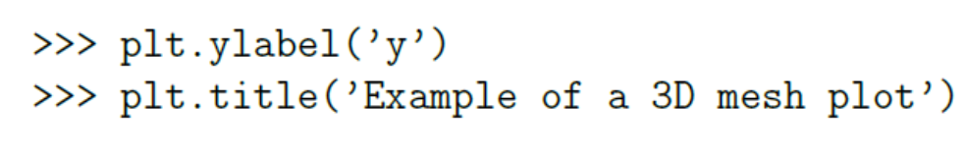
Visualisation
3D-plotting

Slide 19
Programming
Function files
Control structures
  if
  while
  for

Slide 20
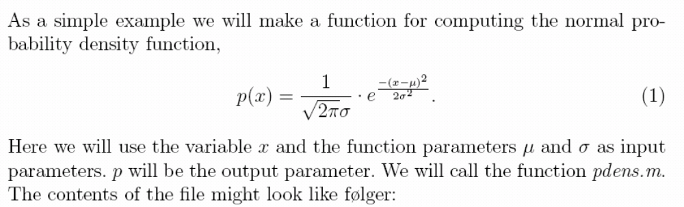
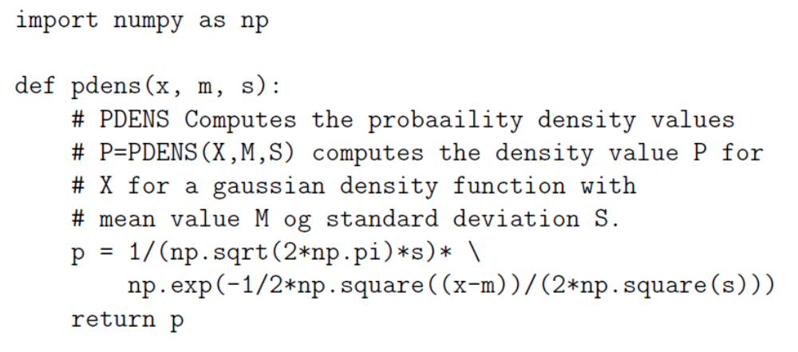
Programming
Function files

Slide 21
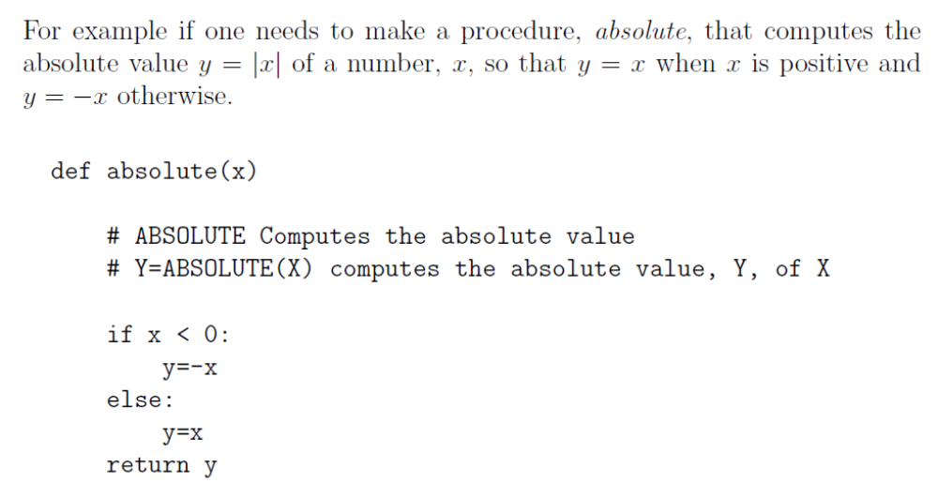
Programming
Condition control using if

Slide 22
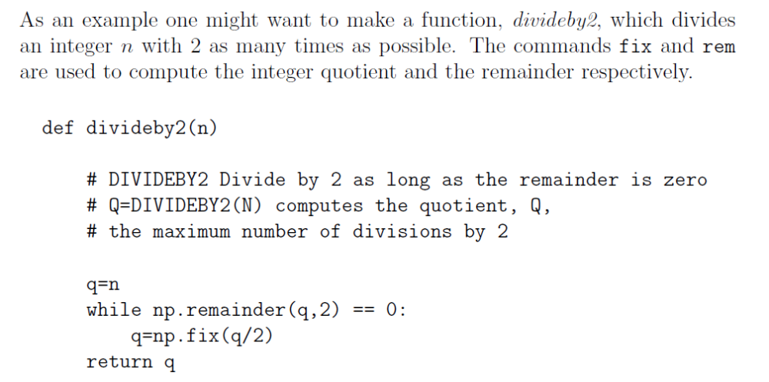
Programming
Iterations using while

Slide 23
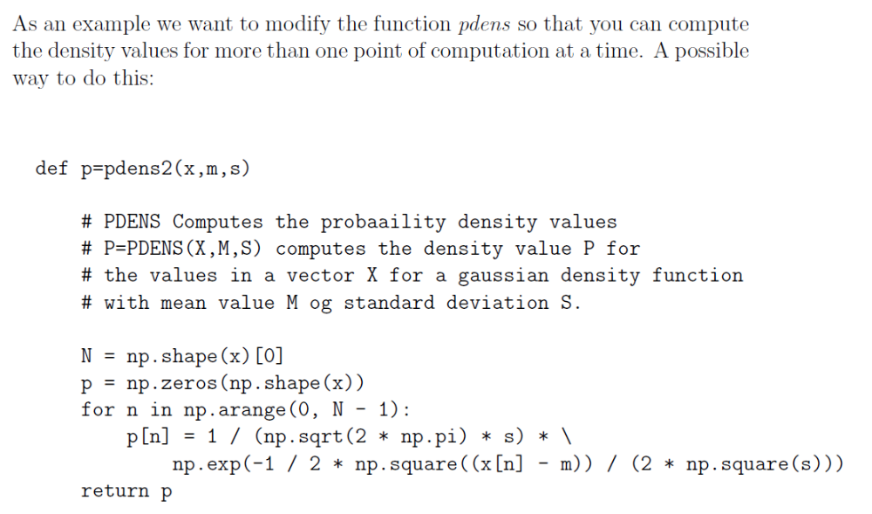
Programming
Iterations using for

Slide 24
Analysis
Estimate pulse rate
  Reading from data file
  Plotting of signal
  Detection of peaks
  Problem – false detections
    Spectral analysis
    Filtering

Slide 25
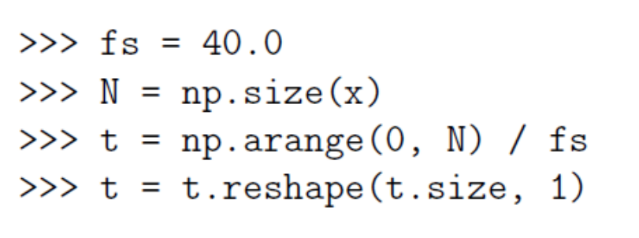
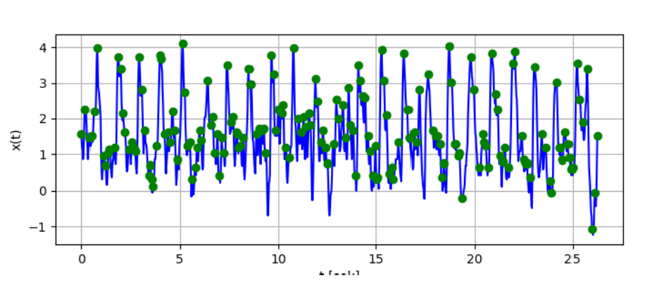
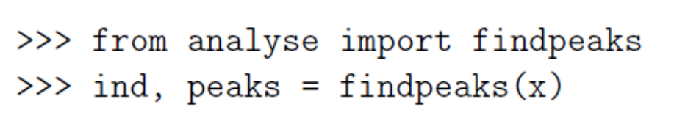
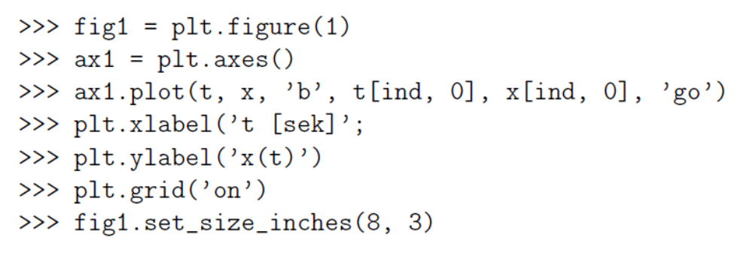
Analysis
Reading from data file
Plotting of signal
Detection of peaks

Slide 26
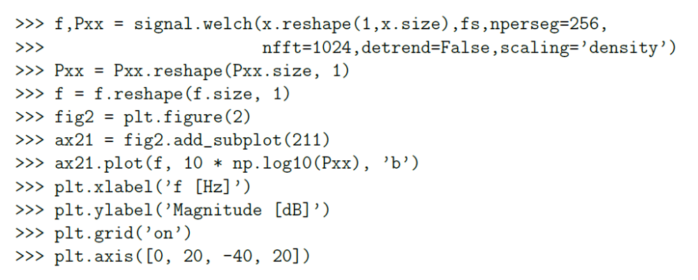
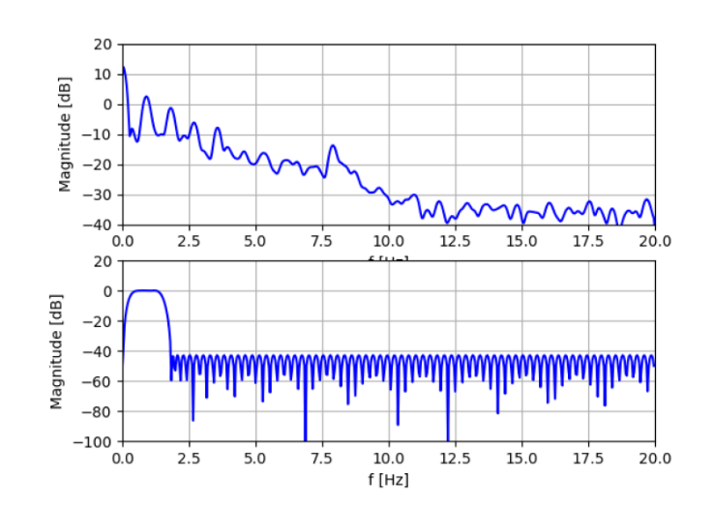
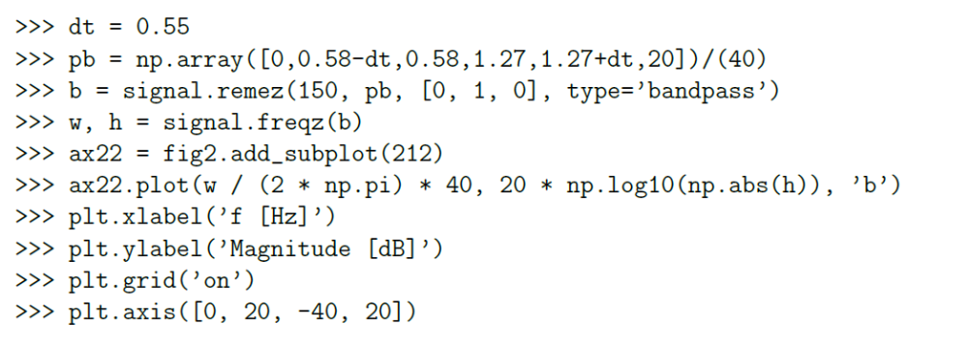
Analysis
Problem – false detections
  Spectral analysis
  Filtering

